Slide 1
Python Basic Notes
Vraj Suratwala

Slide 2
Topics Covered
Matrix, Scalars, vectors and tensors
Arrays in Python - Python Array!

Slide 3
Matrix, Scalars, vectors and tensors
In the context of mathematics and machine learning, scalar, vector, matrix, and tensor are all different types of mathematical objects that represent different concepts and have different properties.
Scalars : Scalars are singular numerical entities, devoid of any directional attributes.
They serve as the elemental components utilized in mathematical computations and algorithmic frameworks across these domains.
In practical terms, scalars often represent fundamental quantities such as constants, probabilities, or error metrics.

Slide 4
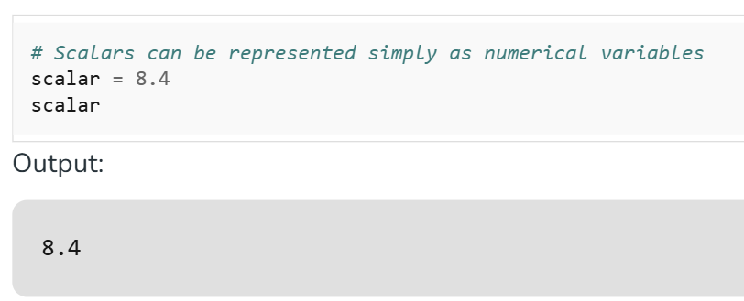
Scalars
For instance, within Machine Learning, a scalar may denote the accuracy of a model or the value of a loss function.

Slide 5
Vectors
A vector is a sequence of numbers arranged in a single row or column, representing an element of a vector space. In Python, vectors can be implemented using lists, NumPy arrays, or other libraries.
Key Features :
Single-dimensional: Vectors are one-dimensional, unlike matrices which are two-dimensional.
Efficient Operations: Libraries like NumPy allow vectorized operations, enabling faster computations without explicit loops.

Slide 6
Vectors
Example :
import numpy as np
# Creating a vector
vector = np.array([1, 2, 3])

Slide 7
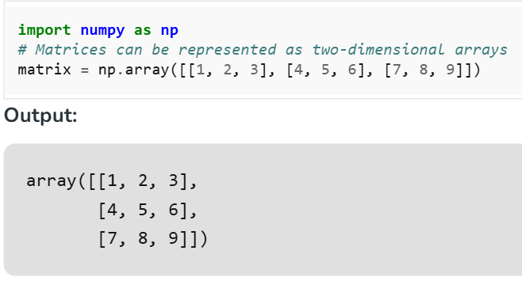
Matrix
Matrices, as two-dimensional arrays of numerical values, enjoy widespread utility across AI-ML-DS endeavors.
They serve as foundational structures for organizing and manipulating tabular data, wherein rows typically represent observations and columns denote features or variables.

Slide 8
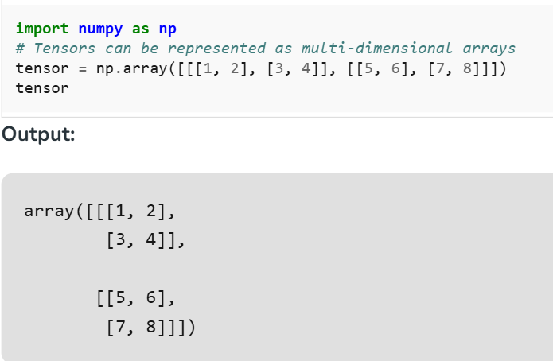
Tensors
Tensors in Data Science generalize the concept of vectors and matrices to better dimensions. They are multidimensional arrays of numerical values which can constitute complex facts structures and relationships.

Slide 9
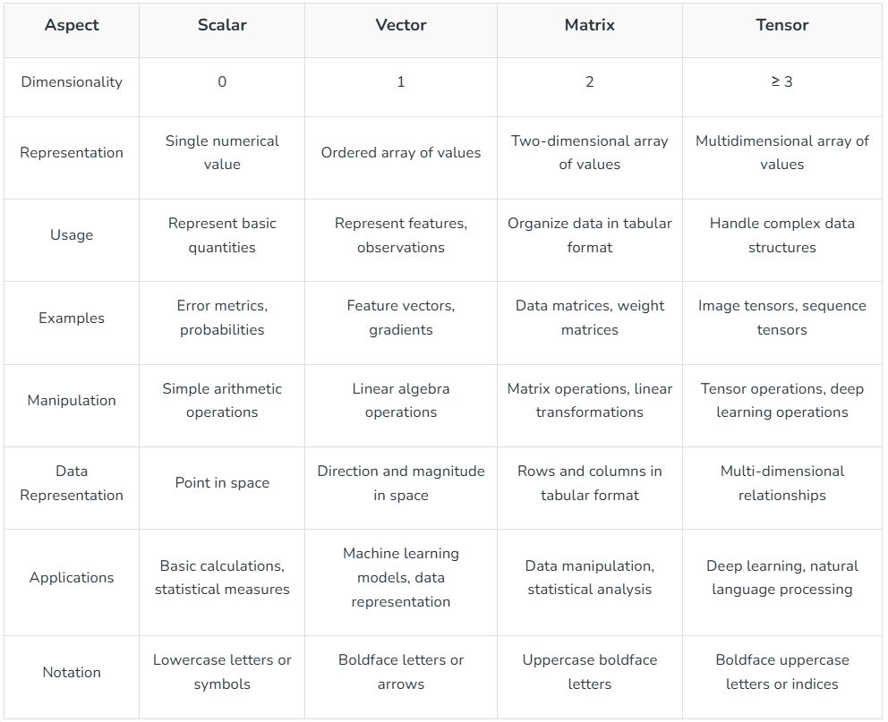

Slide 10
Addition and Subtraction of Matrix
An array in Python is a data structure that stores multiple values of the same data type in a single variable.
Python does not have built-in arrays like C/C++ — instead, it provides the array module.
Arrays are different from lists:
List: Can store elements of different data types.
Array: Stores elements of the same type, more memory-efficient.

Slide 11
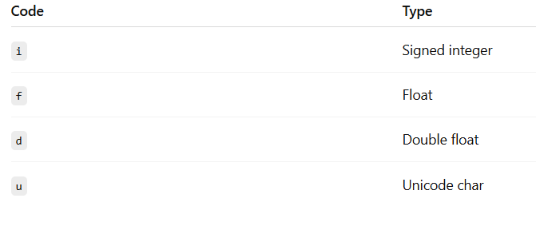
Importing and Creating an Array
importing an array :
import array as arr
Creating an array :
import array as arr
number = arr.array(‘i’, [10, 20, 30, 40])
where i is representing the integer data type!

Slide 12
Accessing that Array and Modifying it!
Access :
print(numbers[0]) # First element
print(numbers[-1]) # Last element
Modifying :
numbers[1] = 25
numbers.append(50) # Add element at end
numbers.insert(2, 35) # Insert at position
numbers.remove(25) # Remove by value
numbers.pop(1)
Looping :
for num in numbers:
print(num)

Slide 13
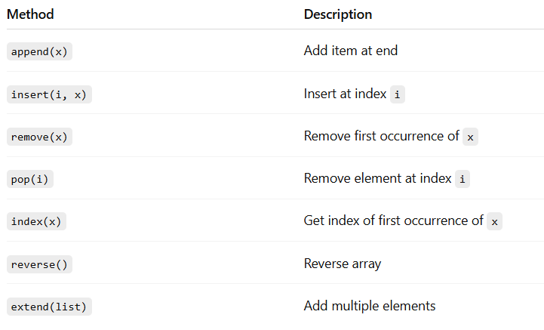
Method of Python Array

Slide 14
Advantage and Disadvantages of Python Array
Advantages :
Memory-efficient for large same-type datasets
Faster element access compared to lists (when same type)
Disadvantages :
Can store only one Data Type
Less Flexible then Lists

Slide 15
References
https://www.geeksforgeeks.org/machine-learning/difference-between-scalar-vector-matrix-and-tensor/#what-is-scalar
https://copilot.microsoft.com/
https://chatgpt.com/

